Slide 1

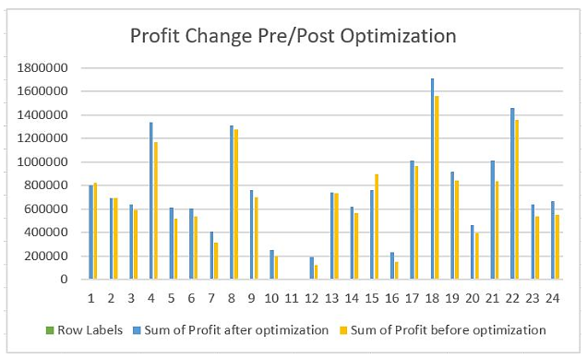
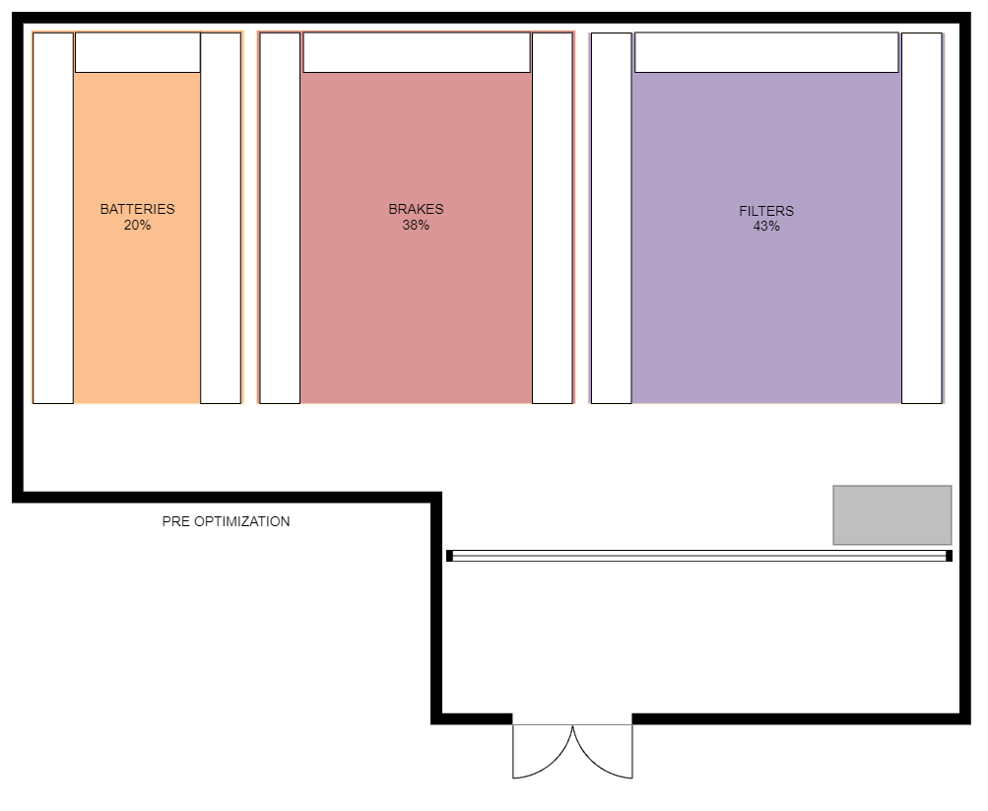
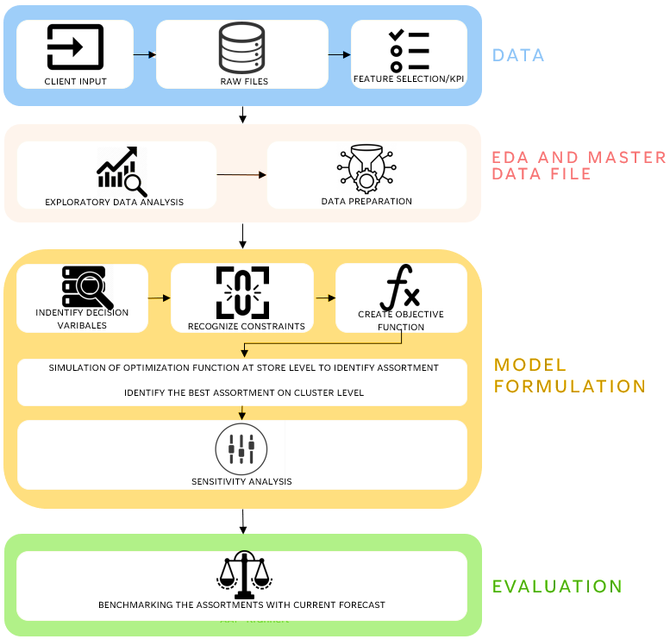
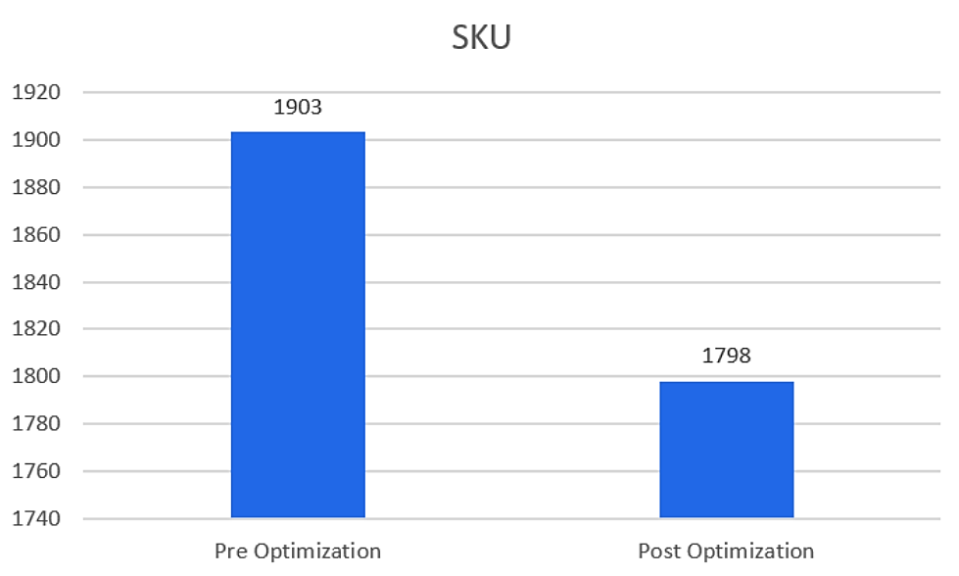
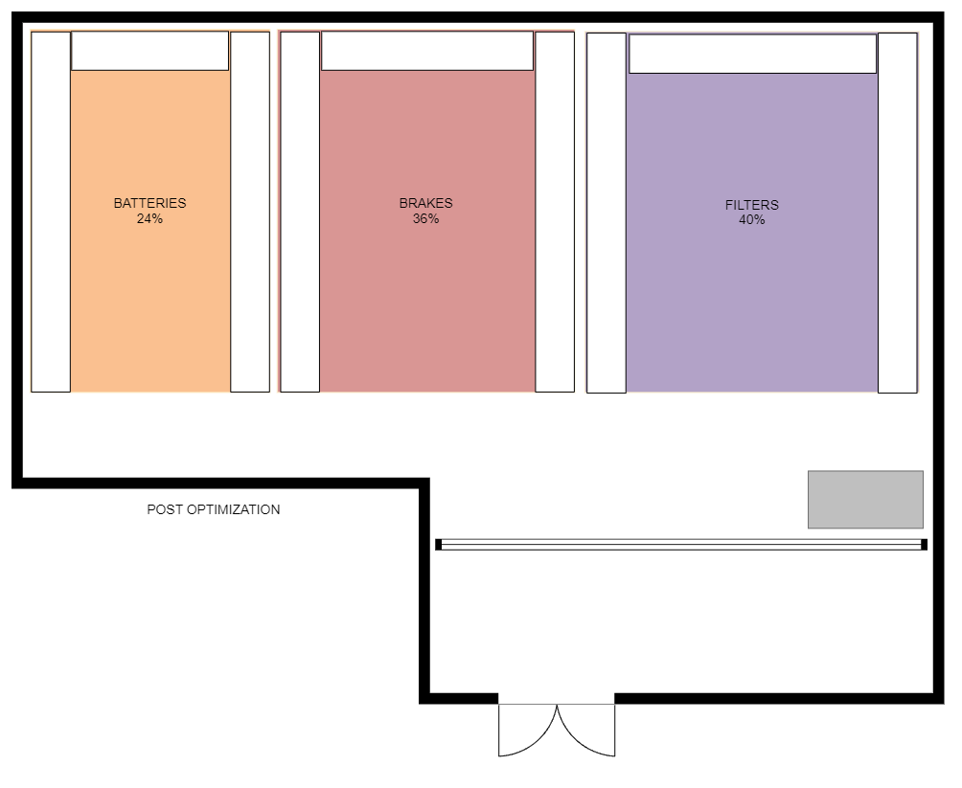
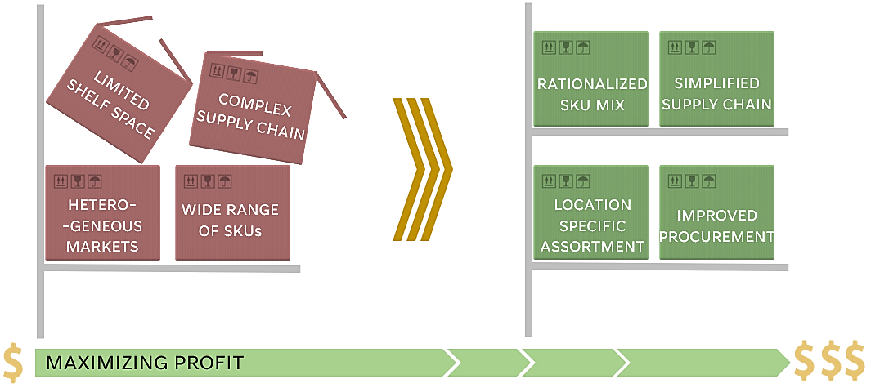
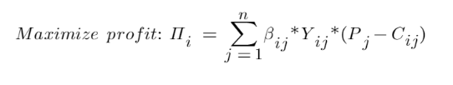
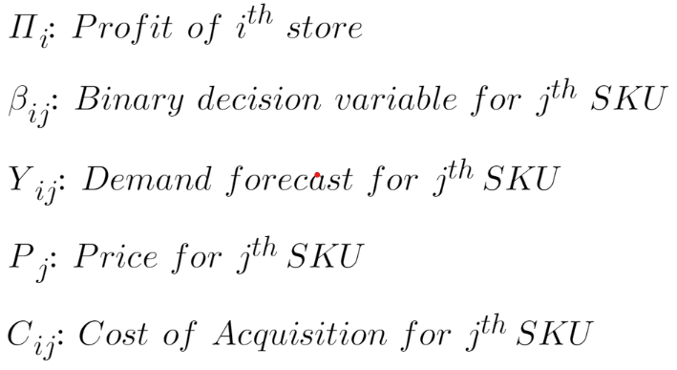
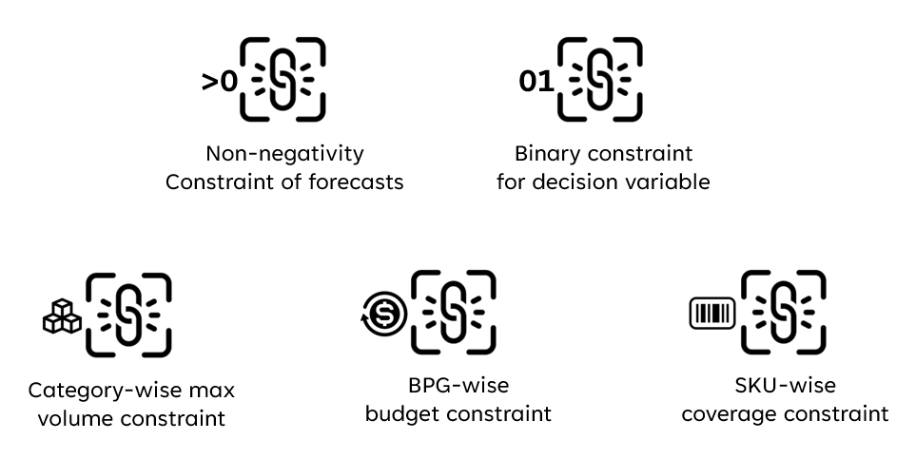
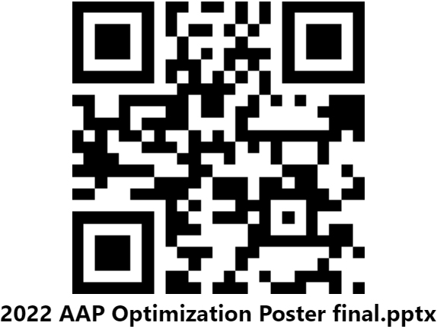
A Hierarchical Approach and Analysis of Assortment Optimization
EXPECTED IMPACT
Our ultimate requirement for the objective function is to maximize the profit from a particular store. Using the constraints of store space, category space, and the budget in a particular store we can expect to find increased profit along with an optimized SKU selection. Post optimization we expect an average increase of 11.24% in Profit per store. SKU selection drops by 4.52%. By changing the required store coverage constraint, we do not significant changes post 82%.
Utkarsh Bajaj, Aaron Chen, Prerana Das, Manandeep Gill, Dhruv Shrivastava, Toolika Agarwal, Matthew A. Lanham
Purdue University, Krannert School of Management
ubajaj@purdue.edu; chen4065@purdue.edu; das133@purdue.edu; gill129@purdue.edu; shrivad@purdue.edu; tagrawa@purdue.edu; lanhamm@purdue.edu
STATISTICAL RESULTS
The two planograms represent the change in category-wise space allocation before and after our optimization function was applied to the data.
Potential Profit Change Pre/Post Optimization
ABSTRACT
METHODOLOGY
Assortment planning is one of the most important & challenging applications of analytics in retail. Often retailers use a 2-stage approach where in the 1st stage they run thousands of prediction experiments to identify what best captures expected demand. In the 2nd stage, they decide which combination of products will lead to the best sales for a particular store - a classic knapsack-type problem. This work focuses specifically on combinatorial assortment optimization (or 2nd stage) & how the hierarchical nature of the decisions & analysis that needs to occur can lead to drastically different outcomes in-store profitability.
BATTERIES 20%
BRAKES
38%
FILTERS
43%
INTRODUCTION
Legends:
Demand and assortment planning is an important aspect for all retailers. The client needs to make sure that the right products are in the right locations. To accomplish this, the client invests heavily in trying to predict what customers will need to purchase in the future. However, business needs to maximize profit and the product assortment in-store must be gunned towards it. Using data such as inventory, historical sales, geographical activity, budgetary constraints, product variety, & shelf space we formulate various integer programming models to demonstrate how the assortment can change using sensitivity analysis on the constraints. We provide our client with a strategy on how to set those parameters in the assortment optimization process to achieve strategic outcomes. This work was performed using the CVXPY python package on Purdue University’s high-performance Bell cluster, which is one of the top 500 HPCs in the world.
Fig 5. Total change in profit
Fig 3. Pre-Optimization Tree Map
Fig 2. Study Design
Fig 6. Total change in SKUs
BATTERIES 24%
BRAKES
36%
FILTERS
40%
CONCLUSIONS
MATHEMATICAL FORMULATION
The model is extremely configurable & can be modified for customized needs in the future
Inventory data and the remaining base product groups can be added to enhance model performance
The model can be expanded to incorporate the impact of the substitution effect in the assortment optimization function
Higher computational capability can be used to run the optimization model across all the stores
Fig 1. Aim of product assortment optimization
ACKNOWLEDGEMENTS
RESEARCH OBJECTIVES
We would like to thank Professor Matthew Lanham and our industry partner for this opportunity, their guidance, and support on this project.
1. Which SKUs are to be kept and dropped to optimize the shelf space?
2. What is the right assortment of SKUs to meet the firm’s strategic goals?
Fig 4. Post-Optimization Tree Map

